Slide 1



A Visualization Tool for the CIRMMT Distinguished Lecture Series
Marcelo M. Wanderley, Mathias Bredholt, and Christian Frisson

Slide 2
CIRMMT
Centre for Interdisciplinary Research in Music, Media, and Technology
Research institution based in Montreal
Founded in 2001
Currently organized in four research axes
  Instruments, Devices, and Systems (RA1)
    Engineering and mathematics research applied to sound and music
  Music Information Research (RA2)
    Computer applications for music information research
  Cognition, Perception, and Movement (RA3)
    Scientific study of music, from performer to listener
  Expanded Musical Practice (RA4)
    Artistic research

Slide 3
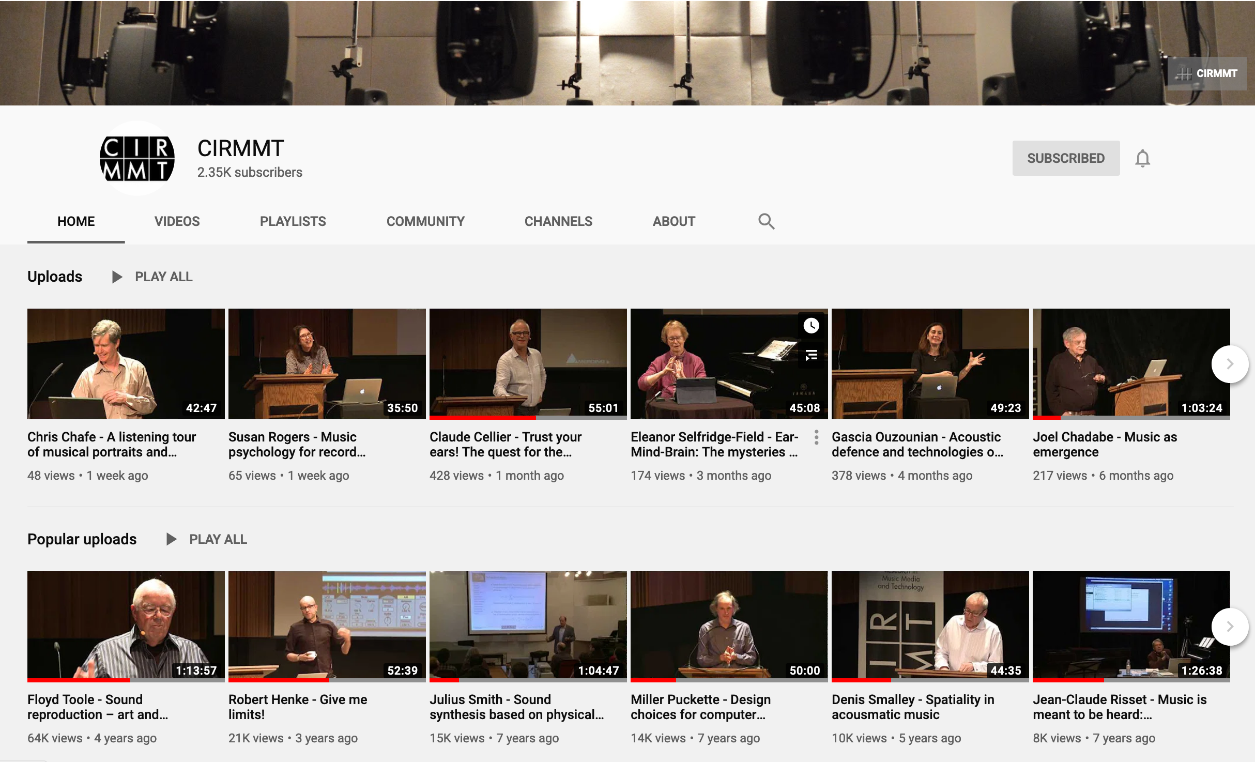
CIRMMT Distinguished Lecture Series
Started in 2005
World-class researchers and artists present a 1-hour overview of their research

Slide 4
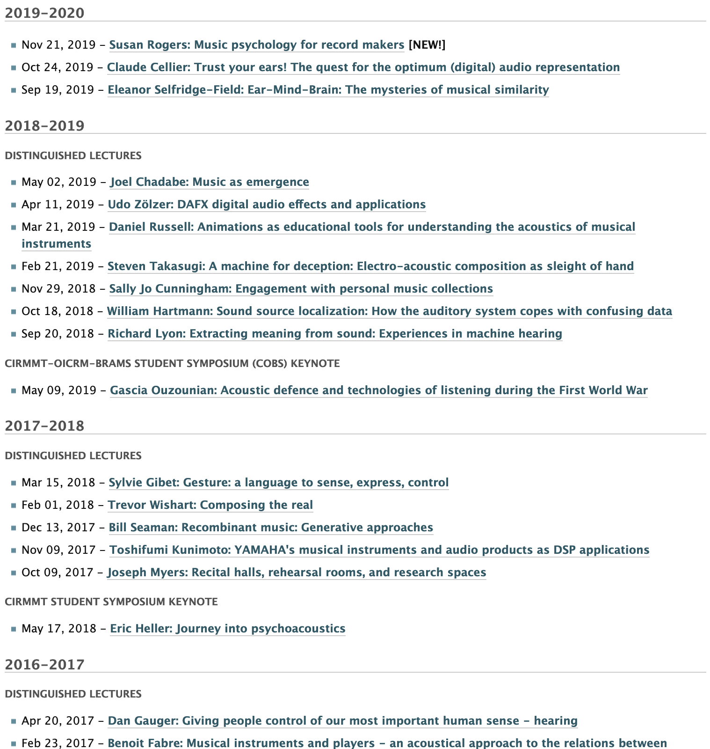
Archiving Lectures and Establishing a DL dataset
Simple list of videos on website

Slide 5
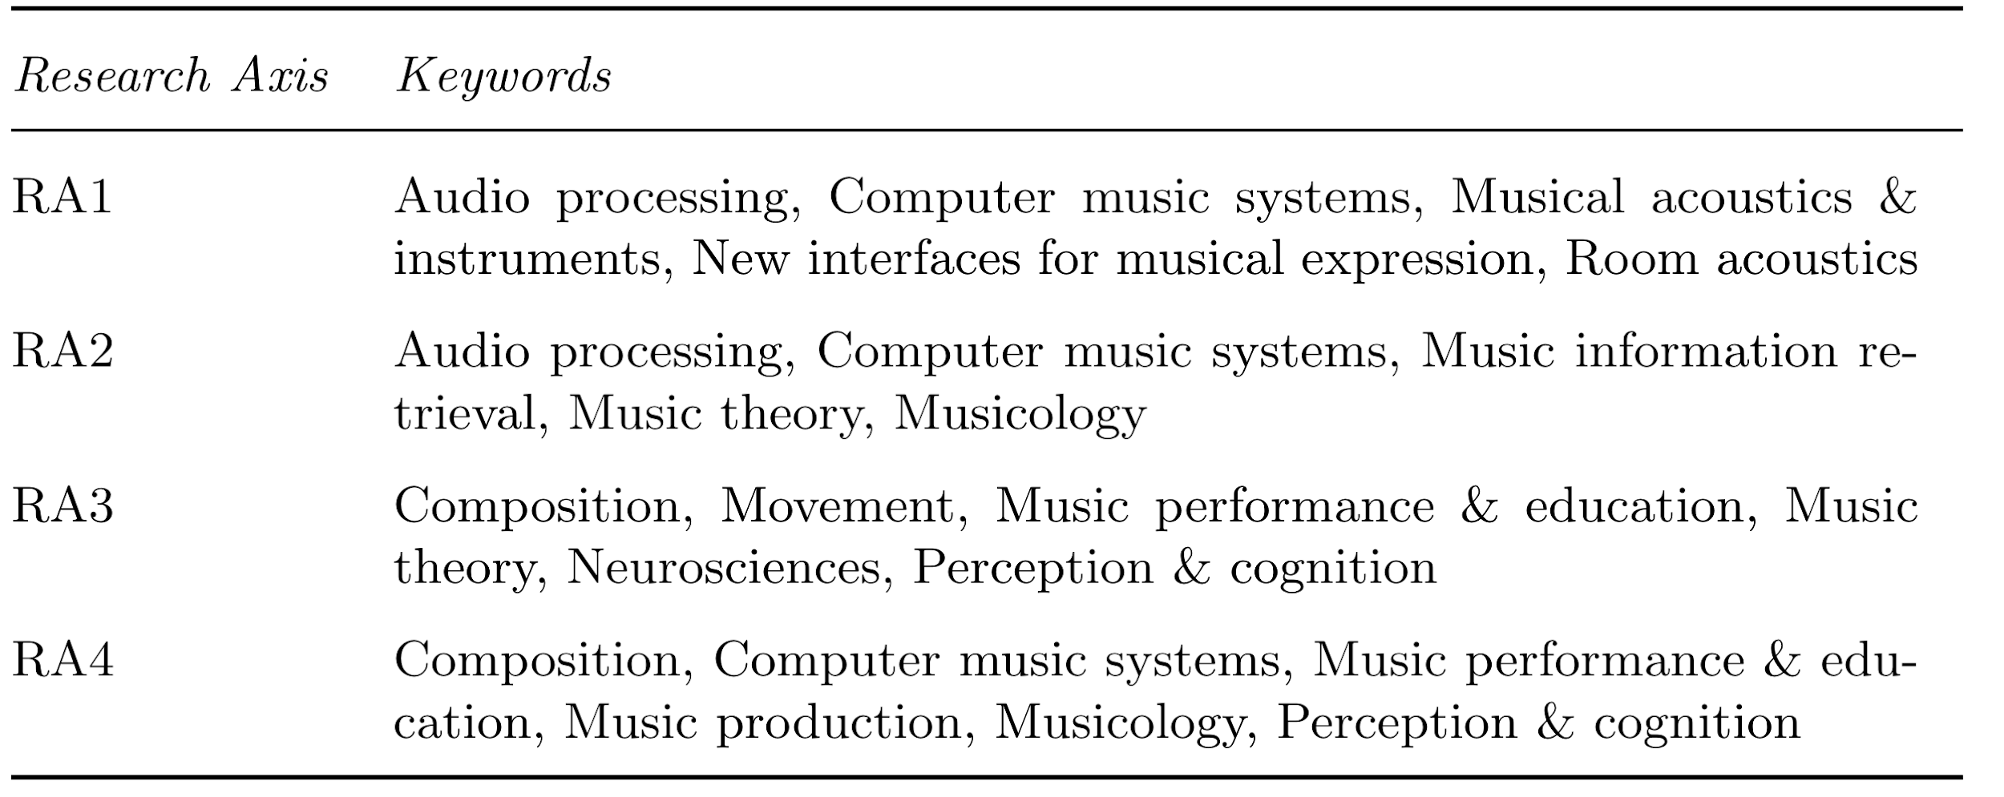
Distinguished Lecture Dataset
CIRMMT graduate students were hired to create dataset
Homogenizing keywords
5-6 keywords per research axis
Same keywords belong to multiple axes

Slide 6
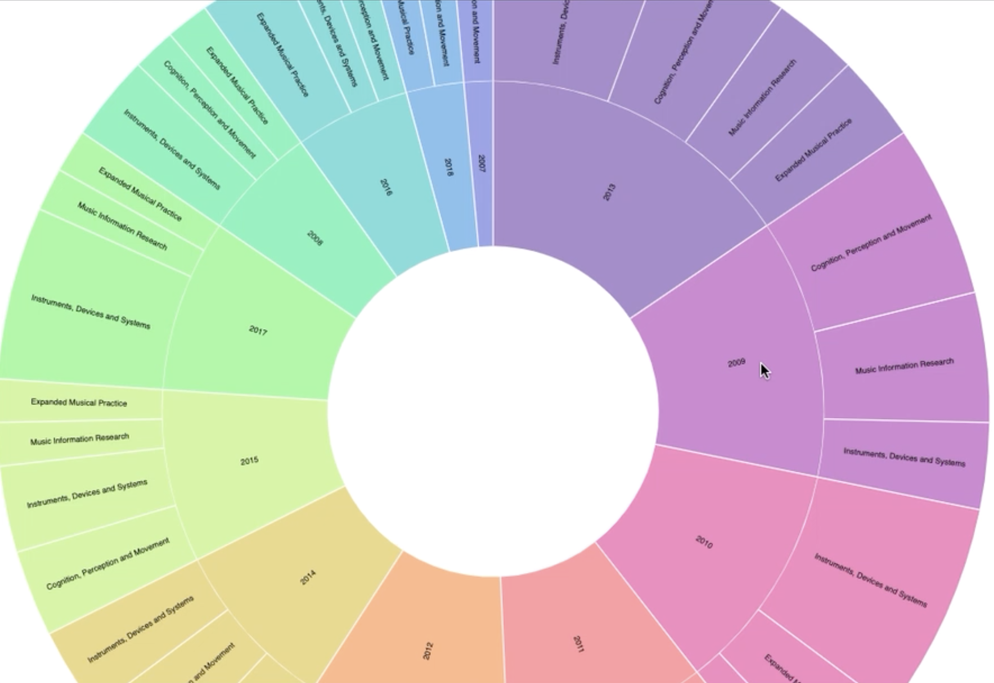
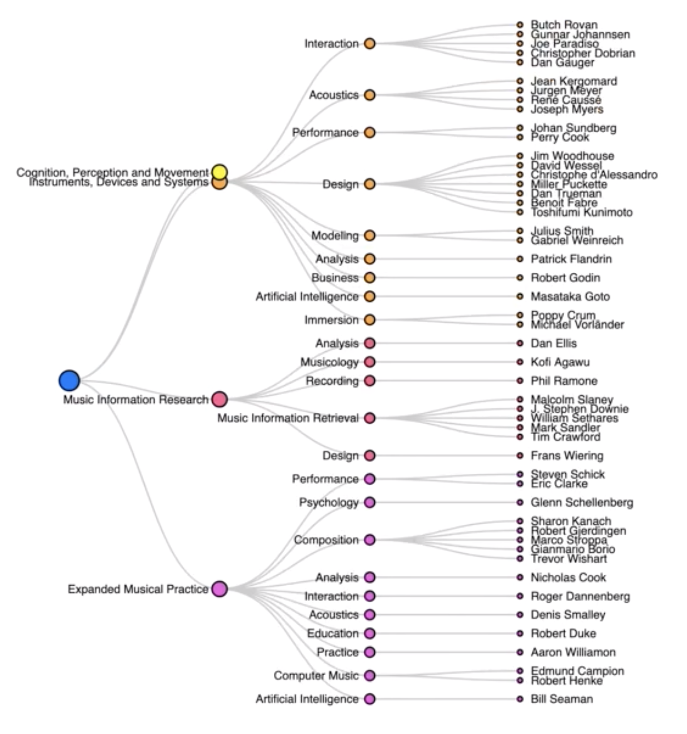
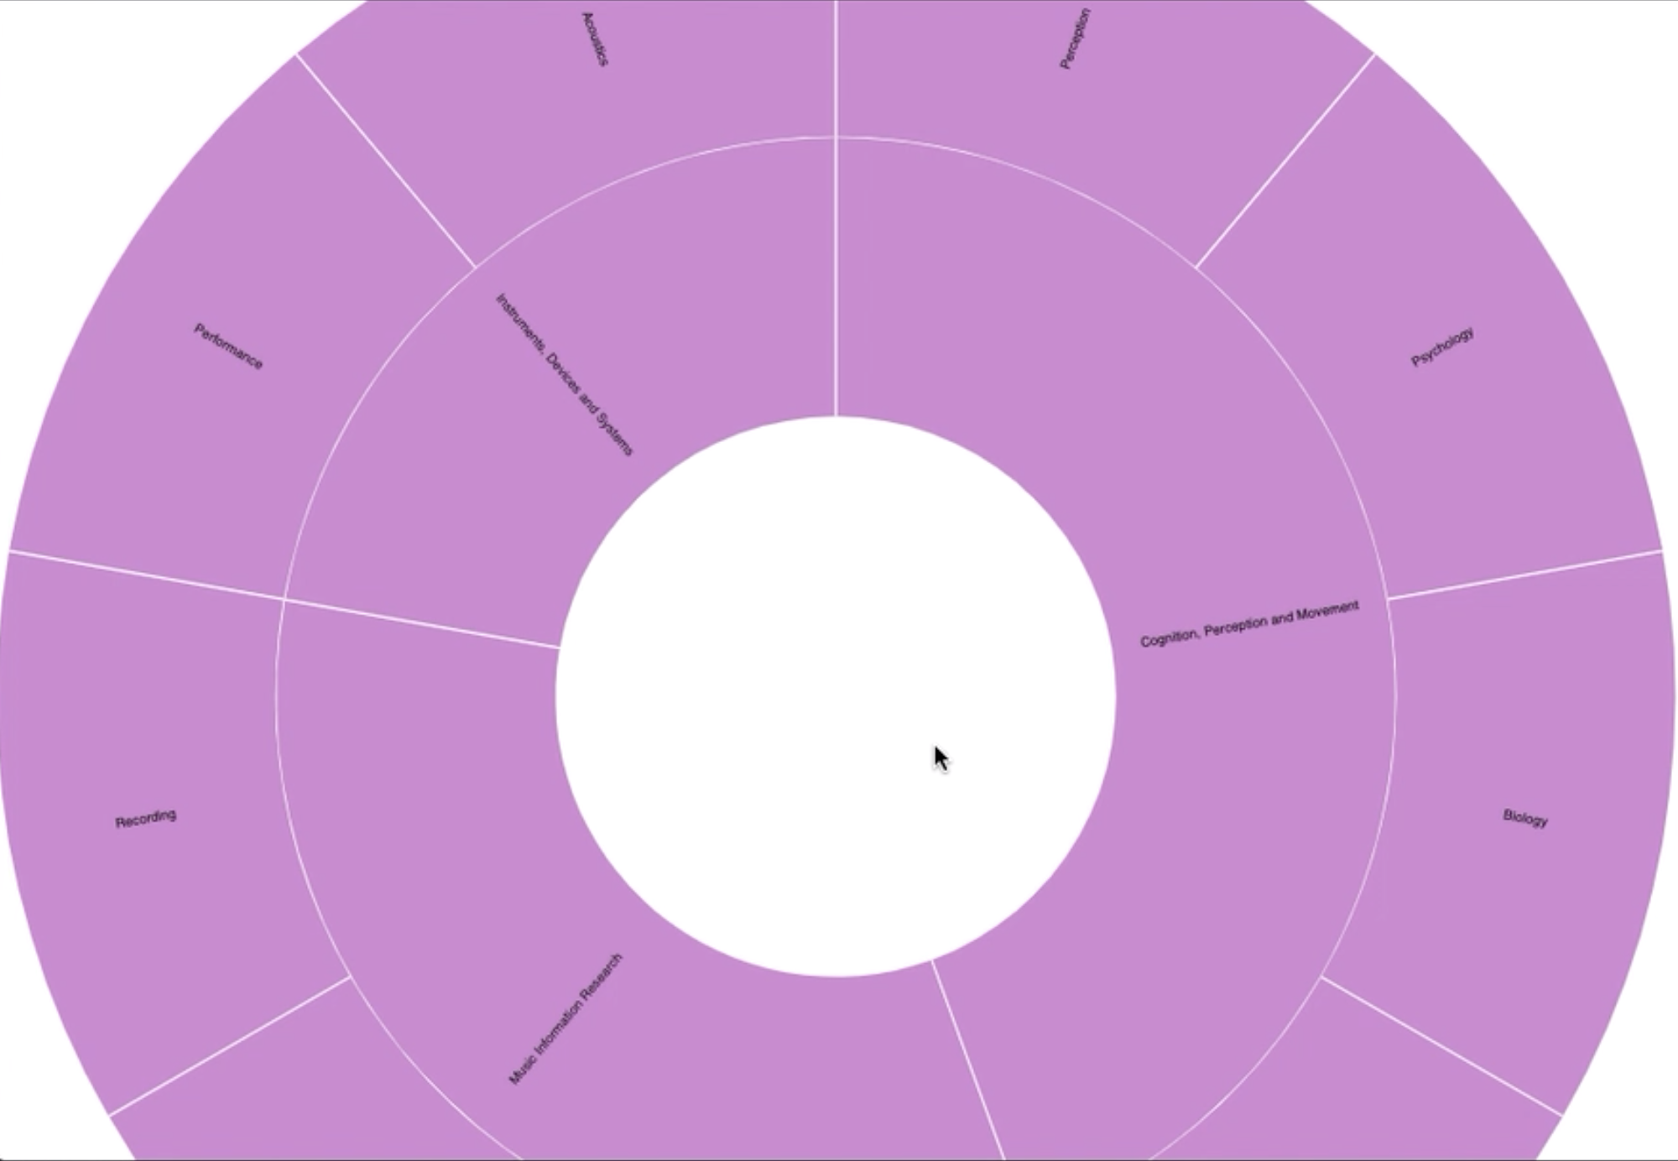
Visualization iterations
Initial prototypes
Dendrogram & Sunburst

Slide 7
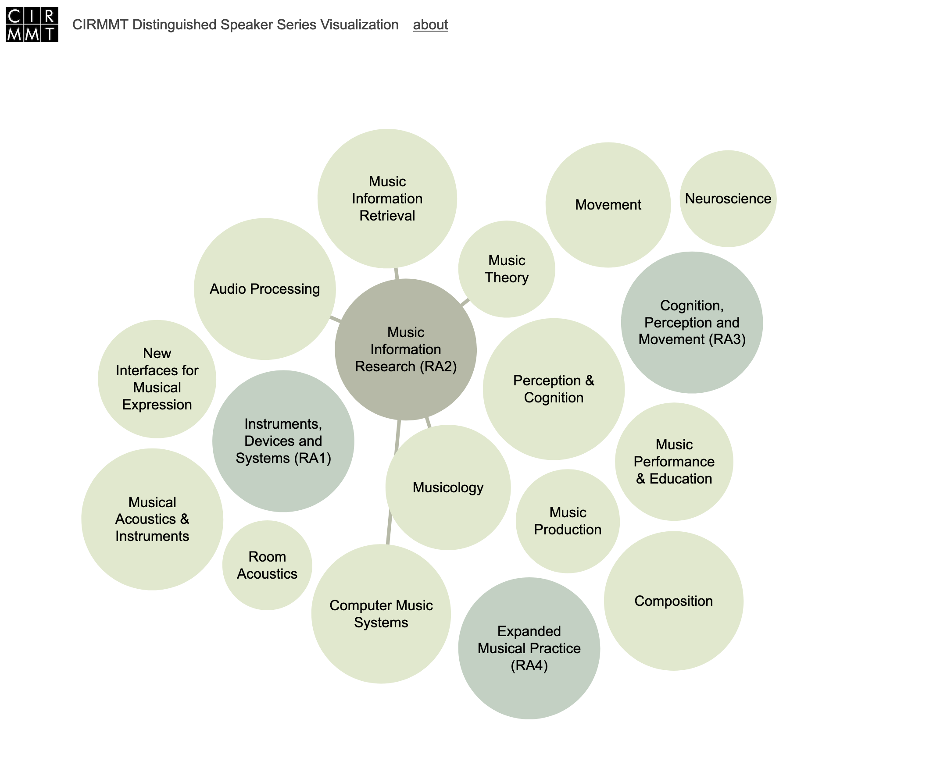
Current prototype
Force-directed layout

Slide 8
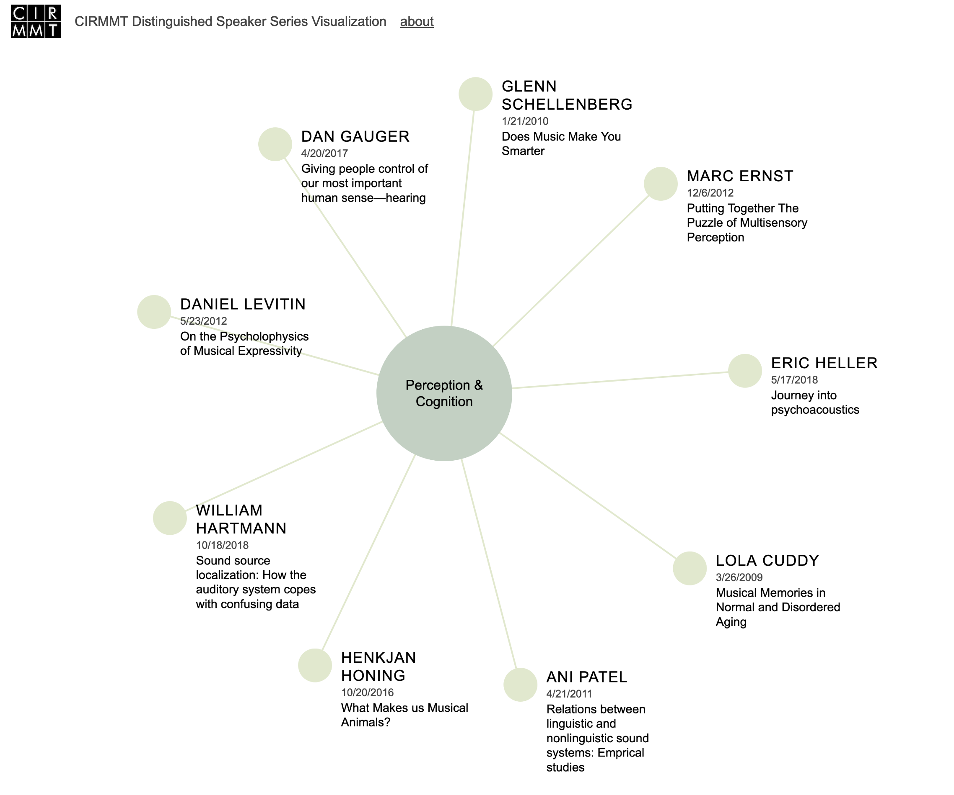
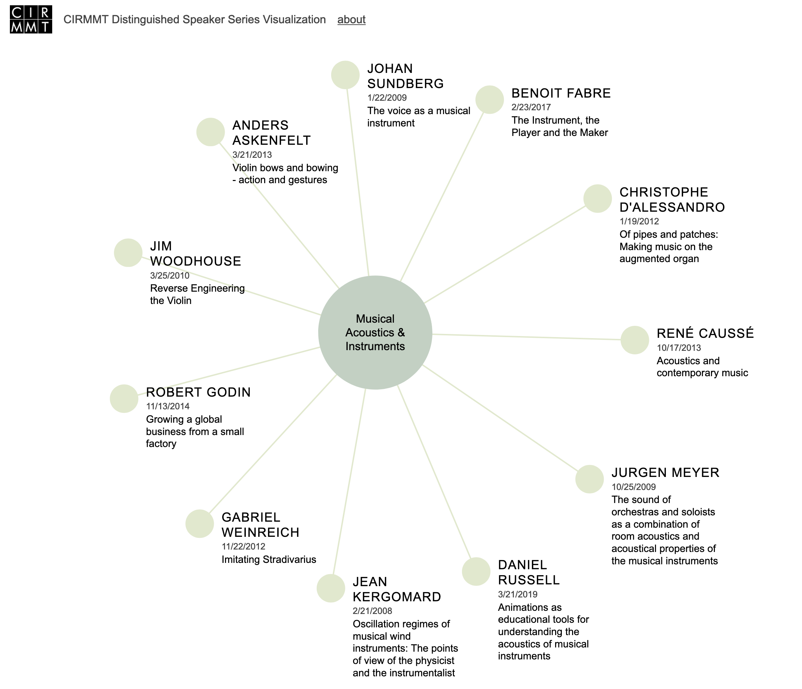
Current prototype

Slide 9
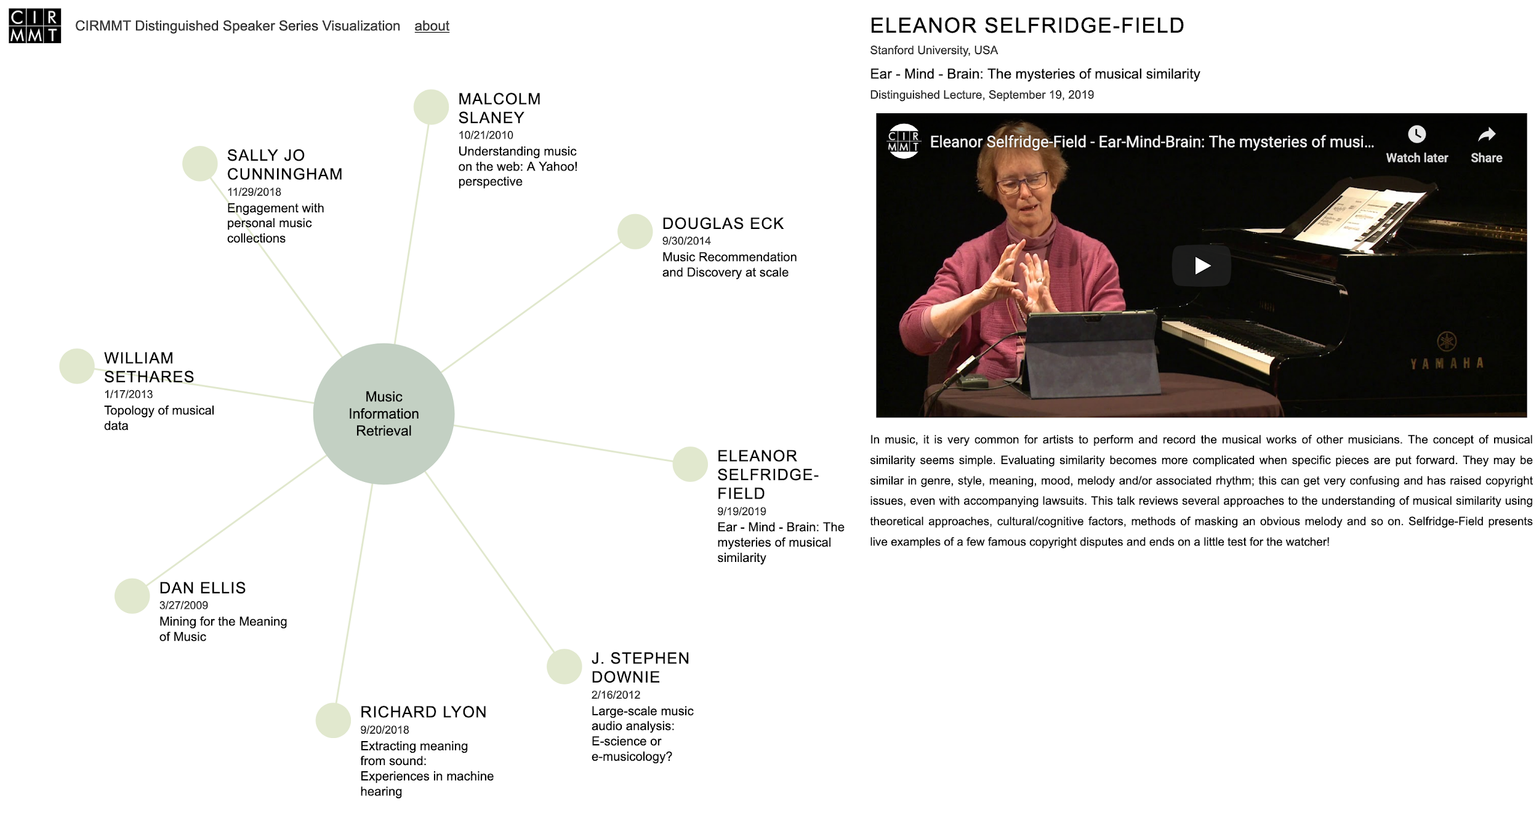
Current prototype

Slide 10
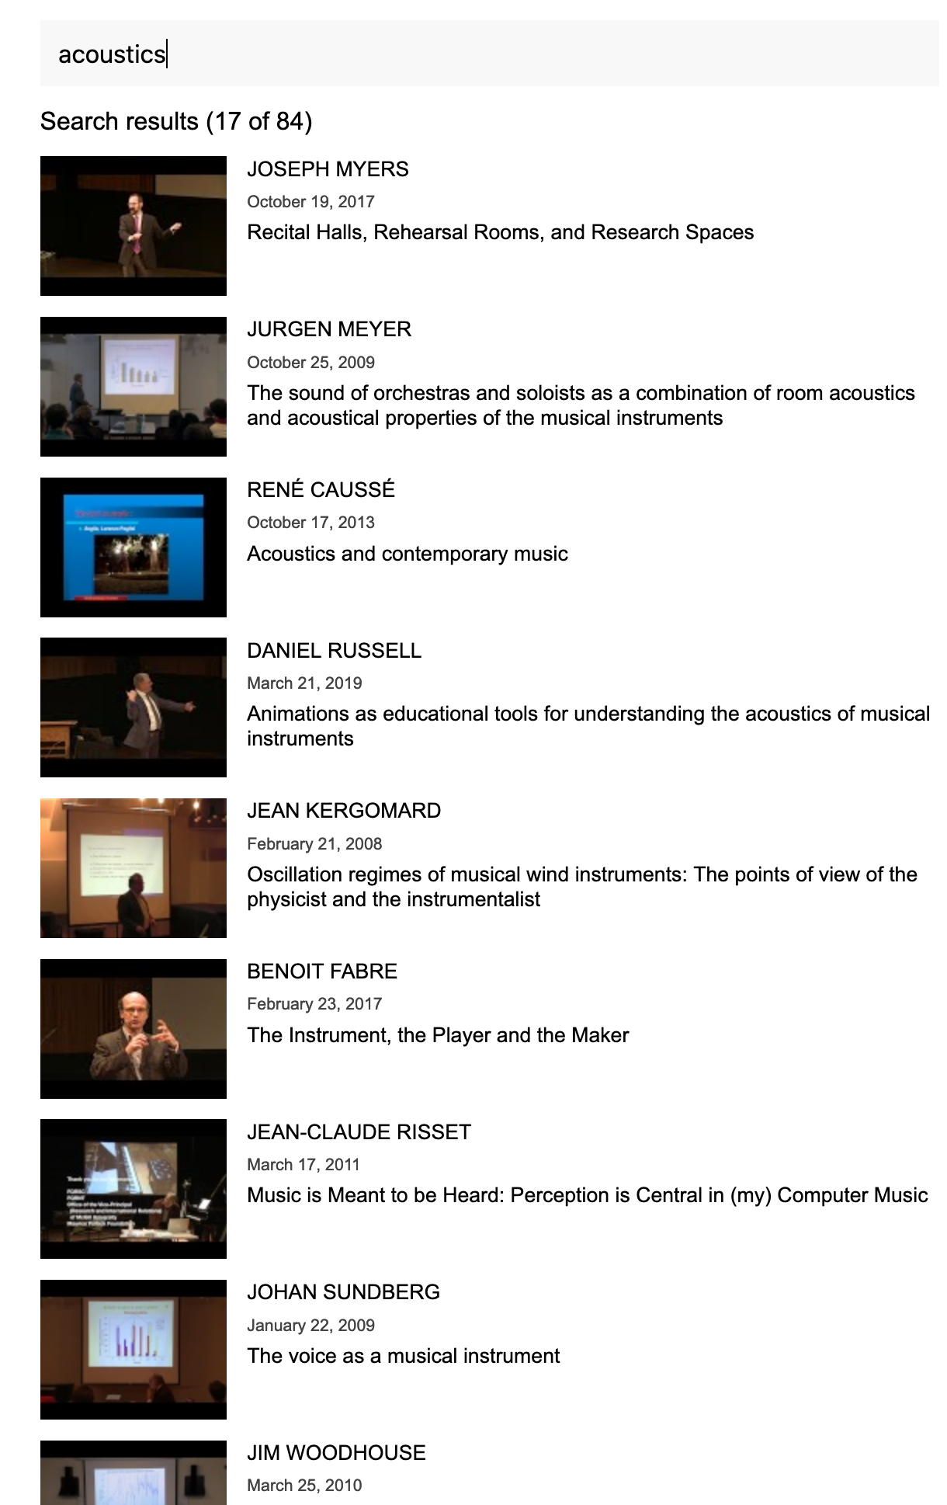
Current prototype

Slide 11
Future work
More advanced choice of keywords
Other visualization techniques
  More than one keyword per video
Automatic extraction of features from videos and their transcriptions

Slide 12
Q&A

